Slide 1


Question number
Anime Character Eyes’ Quiz?
1.
Who is this character?
Time
10
Score
00
Asuka Ninomiya
Karuizawa Kei
Choices

Slide 2
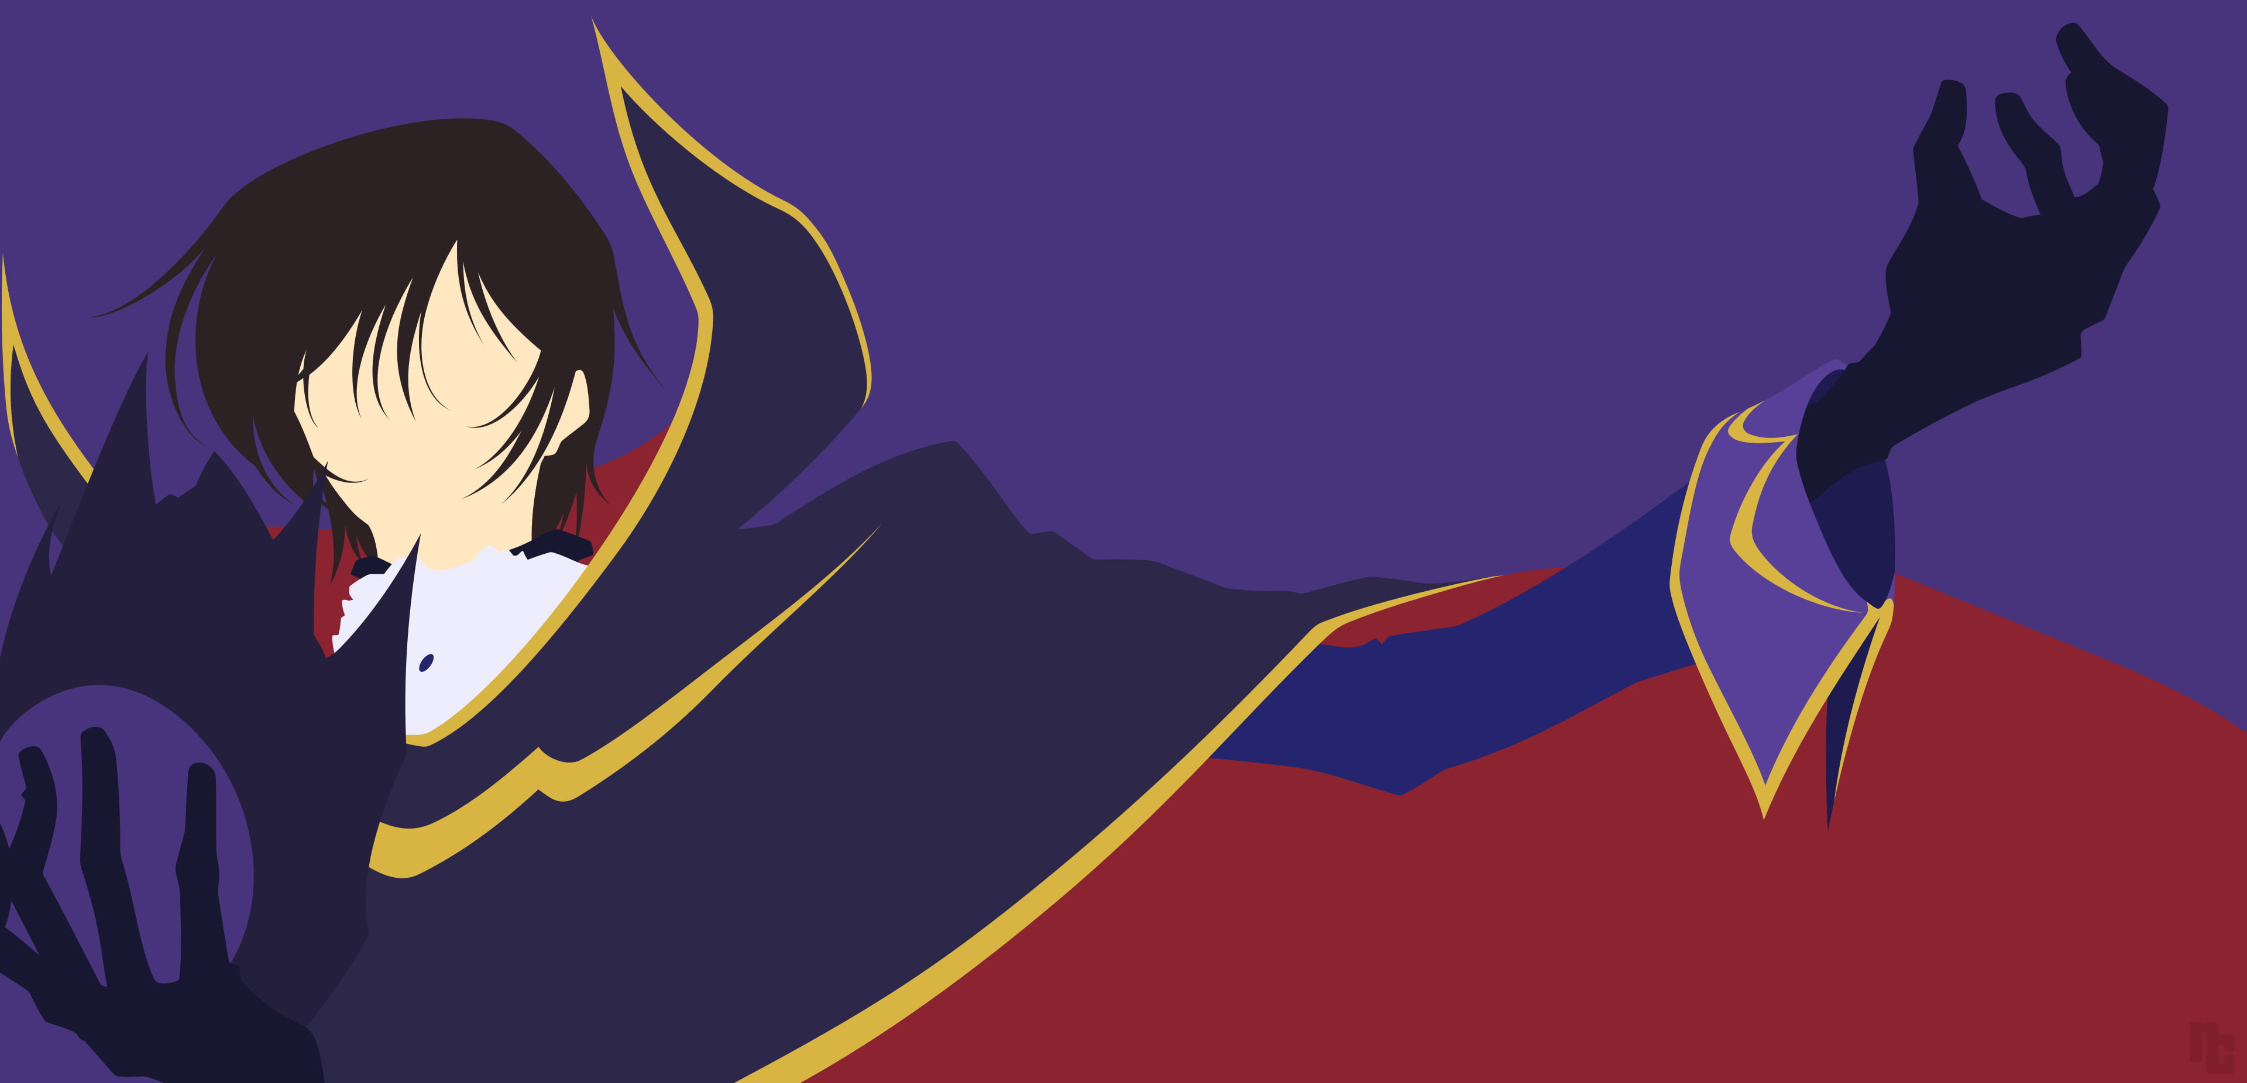
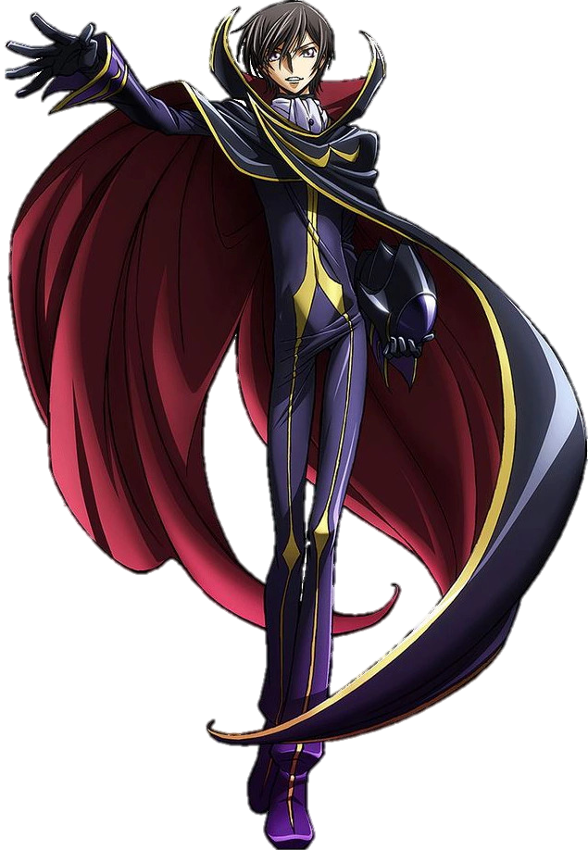
"I, Lelouch vi Britannia, command you! Now, be honest in answering the questions and don't search the characters in web browsers"

